Slide 1
Sipercritical technology
Sudhakar Kumar
Manager (operation)

Slide 2
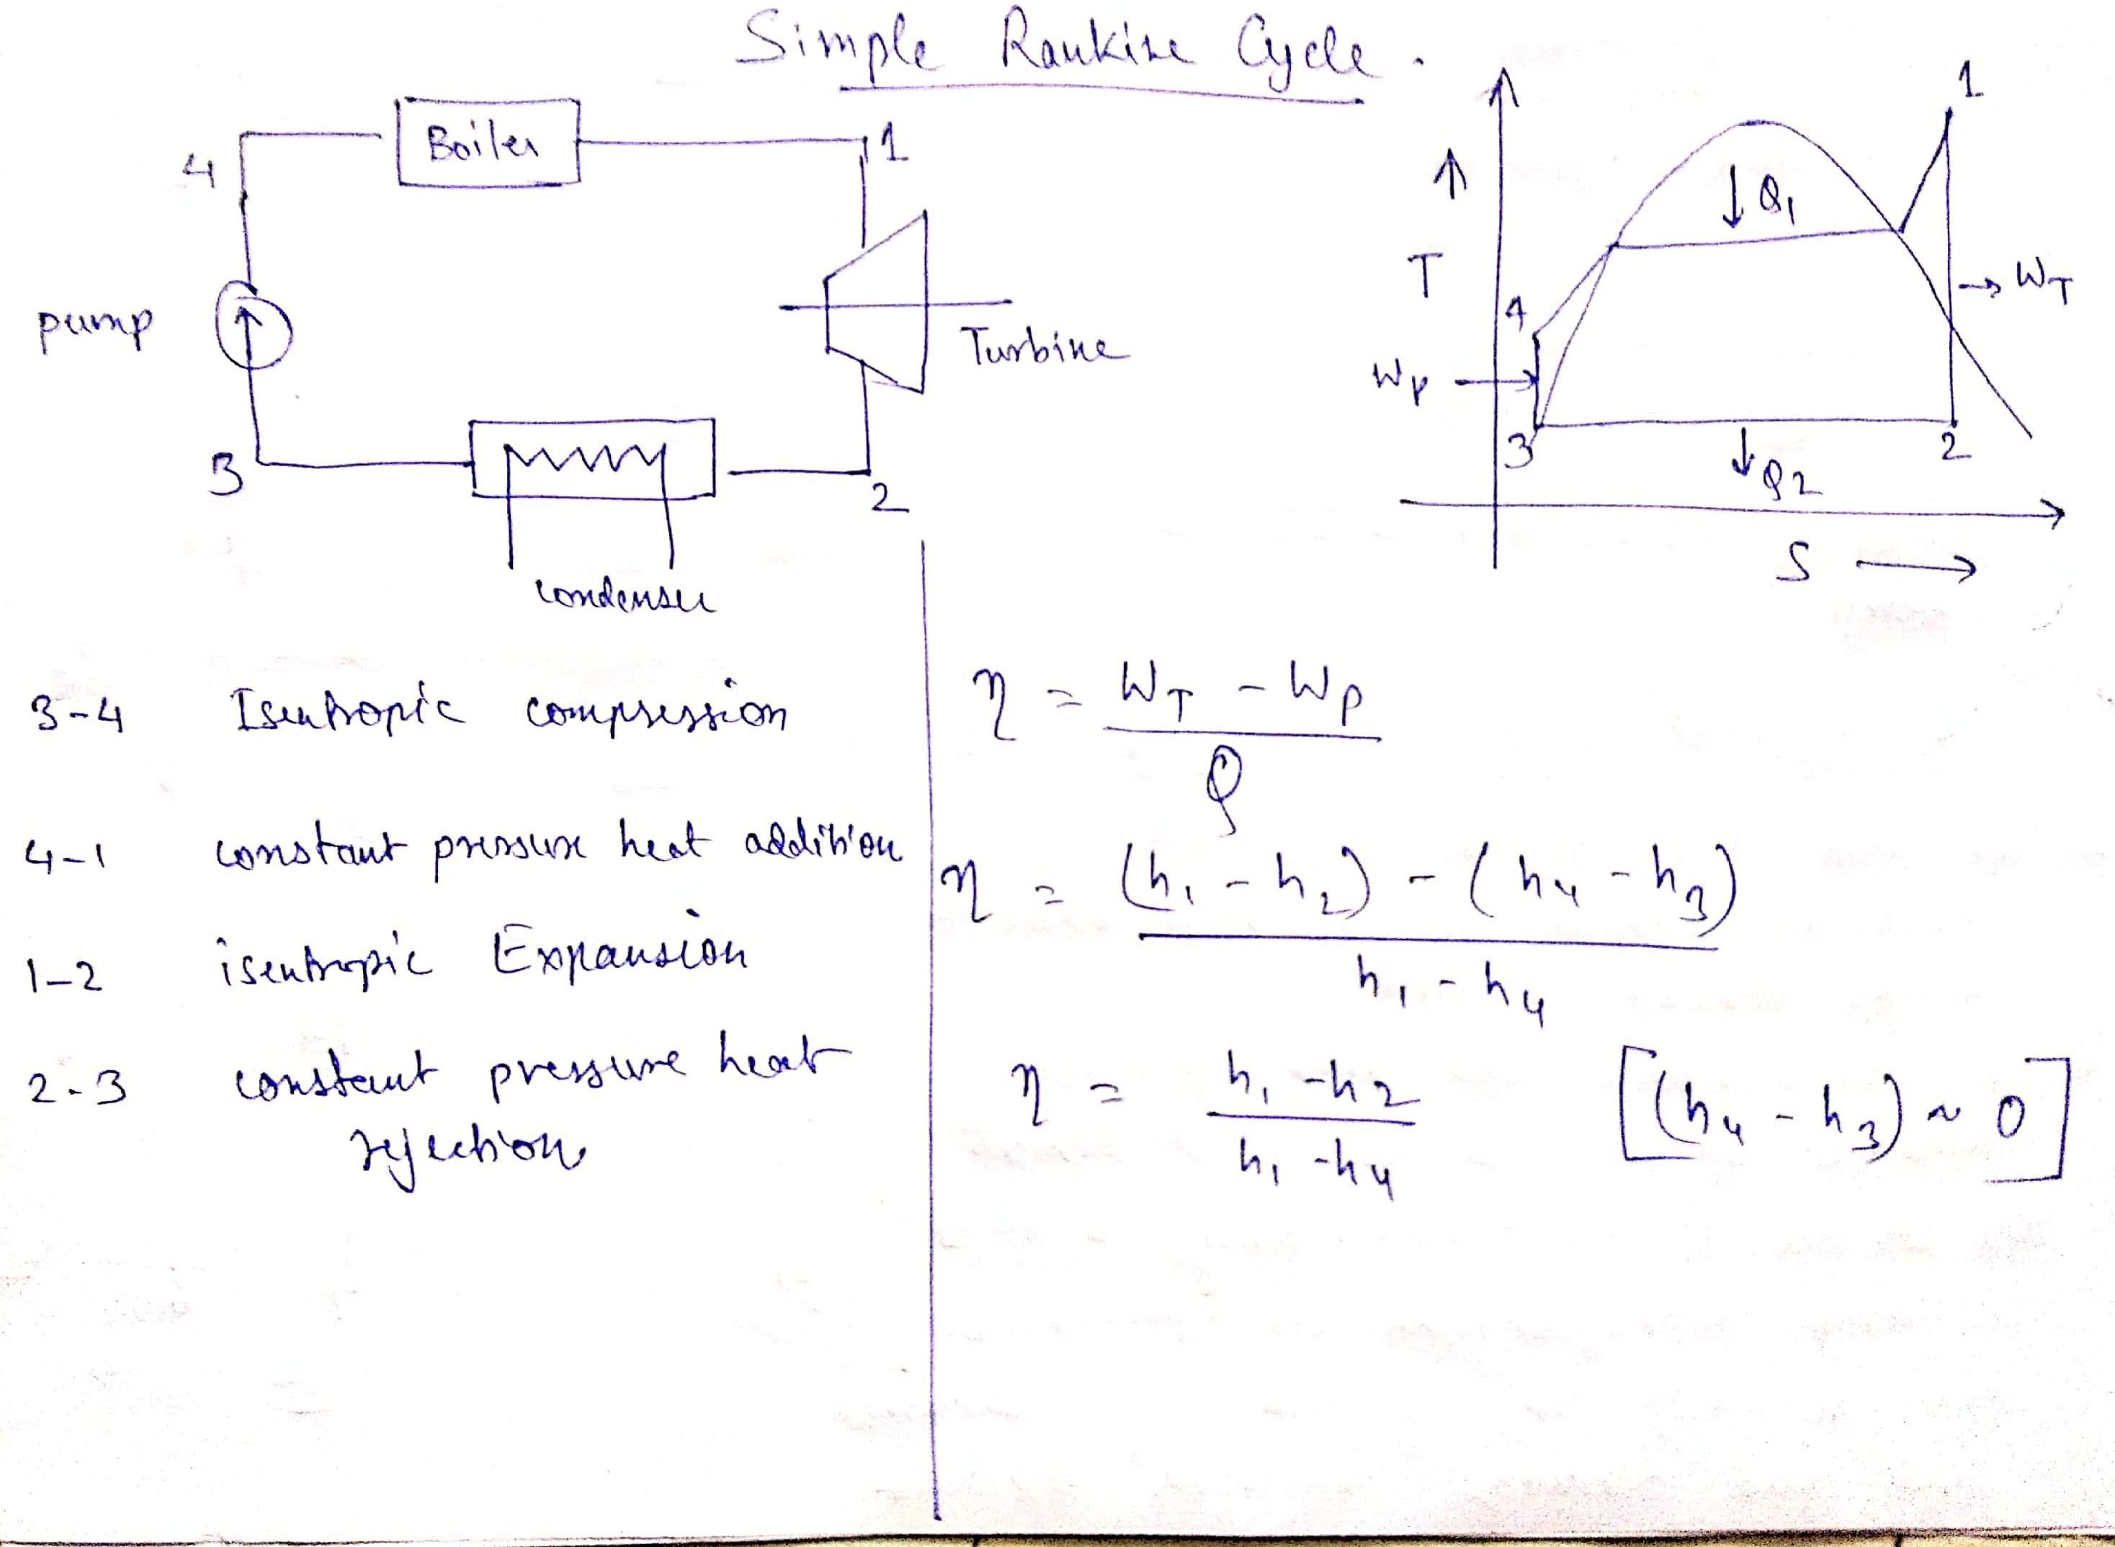

Slide 3
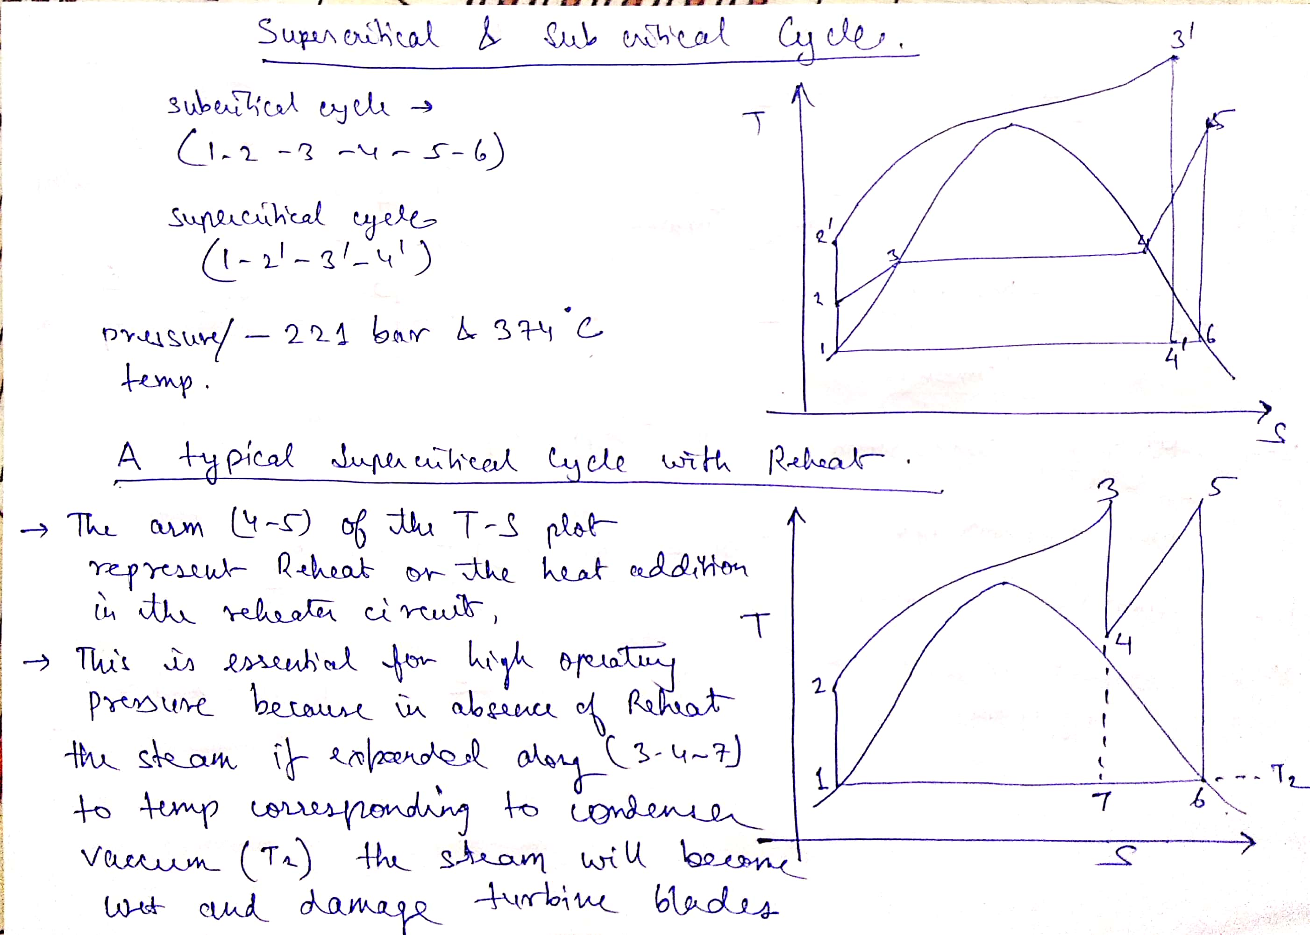

Slide 4
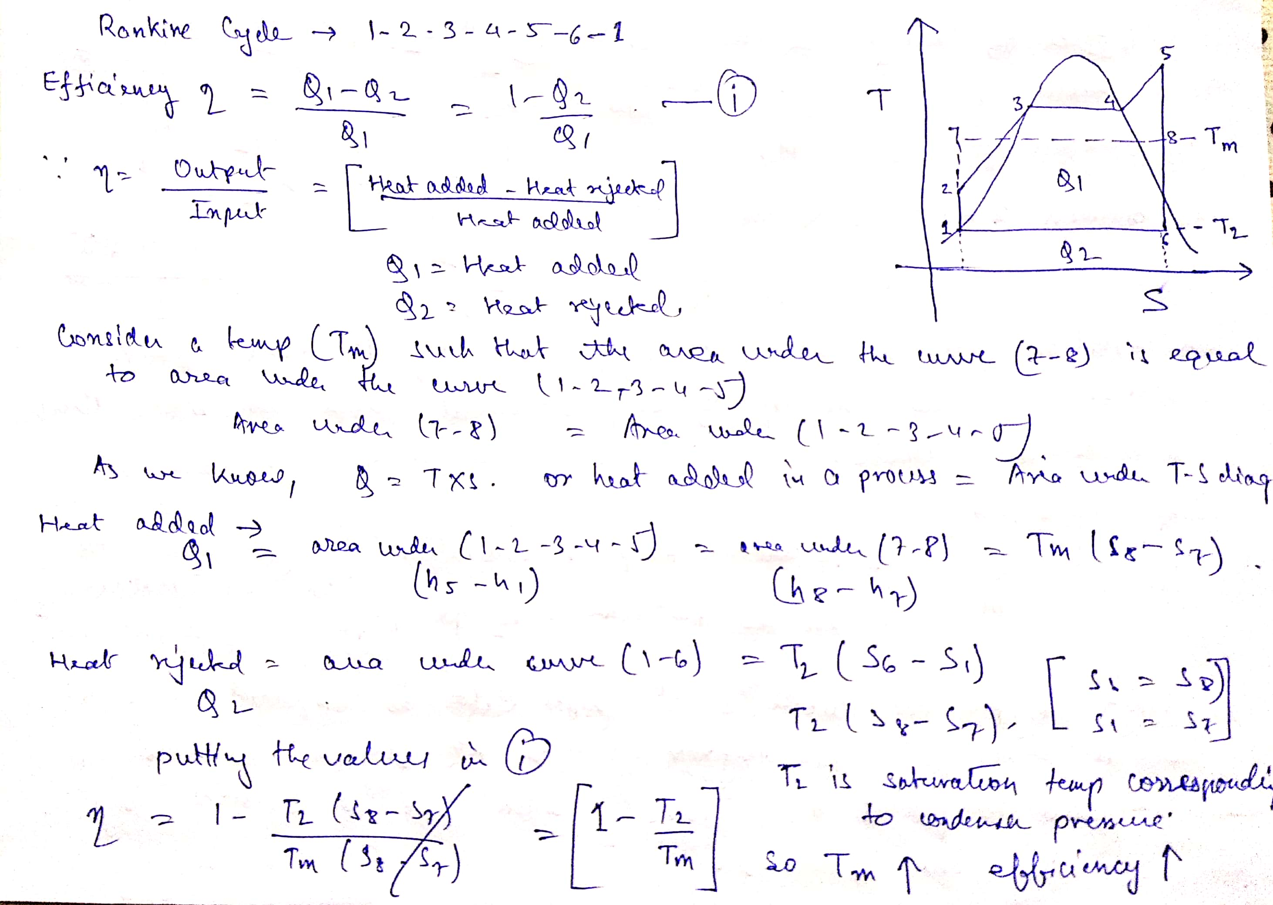

Slide 5
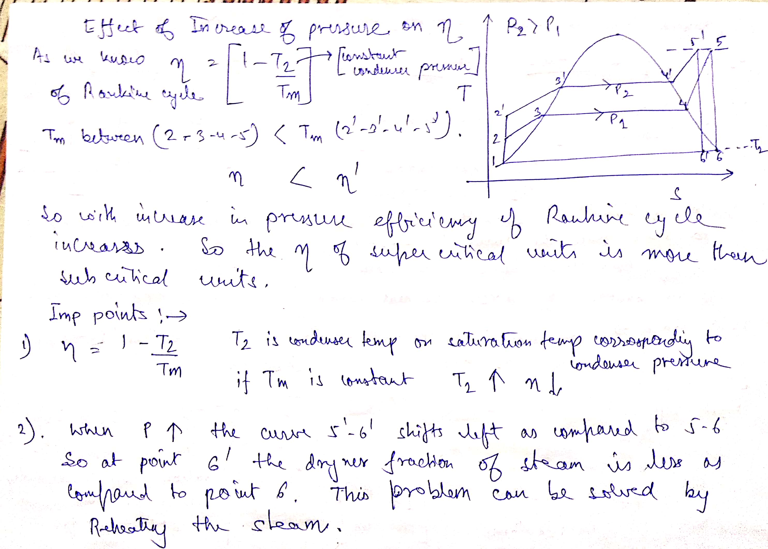

Slide 6
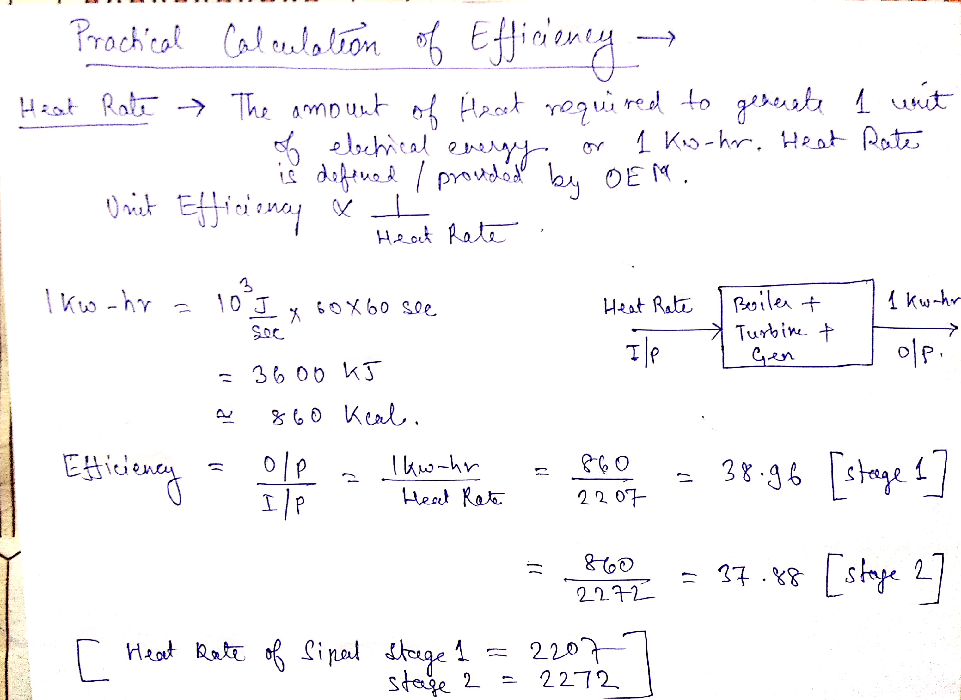

Slide 7
Increase of cycle efficiency due to steam parameters

Slide 8
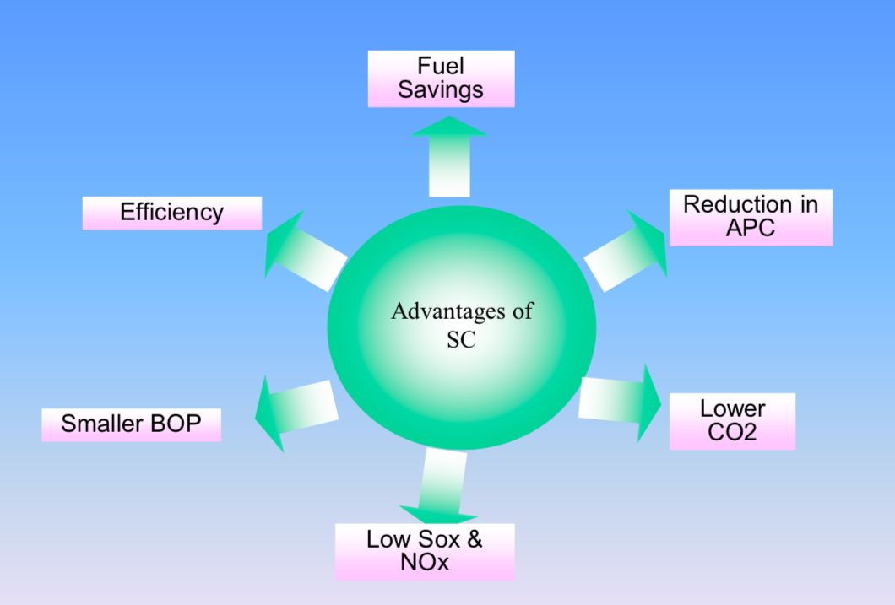
Advantages of supercritical technology

Slide 9
LIMITATIONS ON EFFICIENCY
APPROXIMATE IMPROVEMENT IN CYCLE EFFICIENCY WITH
Pressure increase : 0.005 % per bar
Temp increase : 0.011 % per deg K
Realising higher steam parameters is restricted, to a great extent on the availability of materials to withstand the demanding service conditions.

Slide 10
Special features of sipat stage 1 supercritical boilers
ONCE THROUGH BOILER
SPIRAL WATER WALLS
LOW LOAD CIRCULATION SYSTEM THROUGH SEPERATORS

Slide 11
Types of boilers
A). DRUM TYPE BOILERS. (ONLY IN SUB CRITICAL)
Natural circulation – circulation through thermo-syphon effect
Forced circulation – circulation through thermo syphon effect supplemented by pumps.
B). ONCE THROUGH BOILERS (SUB CRITICAL AND SUPER CRITICAl)

Slide 12
Drum type boiler
Steam generation takes place in furnace water walls
Fixed evaporation end point - the drum
Steam -water separation takes place in the drum
Separated water mixed with incoming feed water
The water is sent down via downcomers and circulates either naturally or is assisted through BCP.

Slide 13
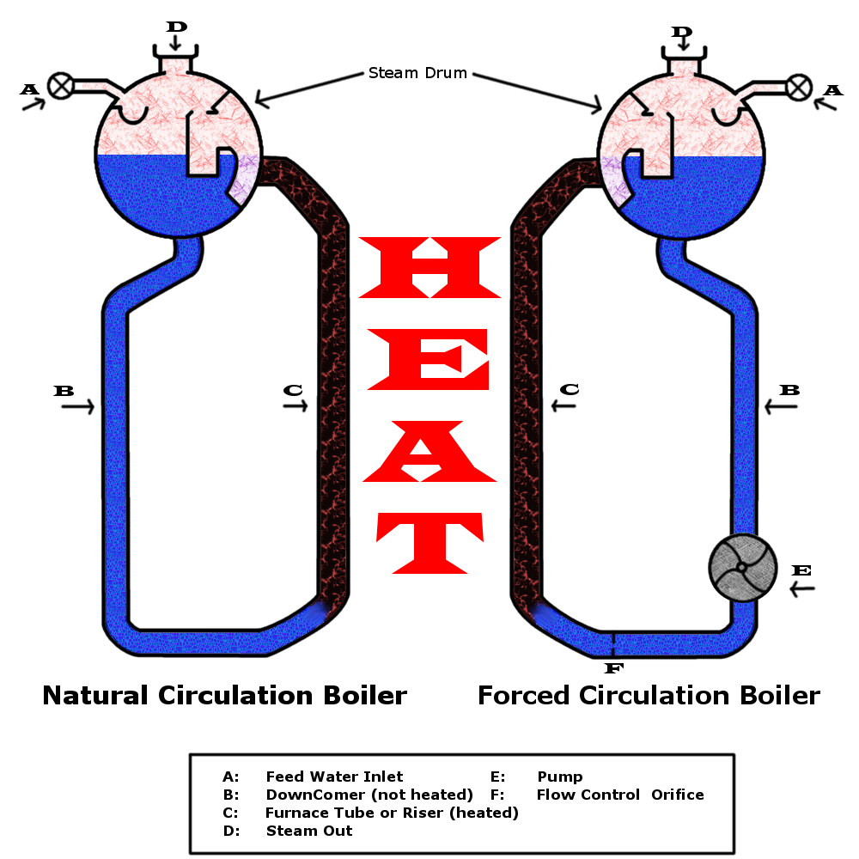
This Photo by Unknown Author is licensed under CC BY-SA

Slide 14
Once through boiler
THE MASS FLOW RATE THROUGH ALL HEATING ELEMENTS ARE THE SAME.
IT IS SUITABLE FOR BOTH SUB CRITICAL AND SUPERCRITICAL BOILER
ALL THE WATER IS CONVERTED INTO STEAM IN ONE GO. SO THERE IS NO NEED OF CIRCULATION OR DRUM.
SINCE THE WATER IS ALREADY SUPERHEATED, NEEDS NO MECHANISM FOR STEAM WATER SEPERATION.

Slide 15
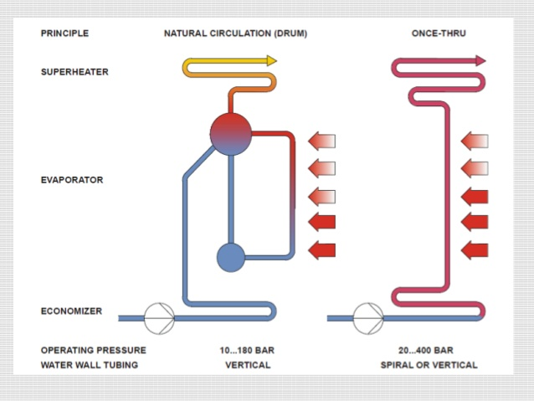

Slide 16
SPIRAL WATER WALLS (advantages)
As the tubes pass through all the furnace walls more uniform heat absorption takes place. Evaporator outlet steam temperatures more uniform.
Tubes spirally wound around the furnace to reduce number of tubes and to increase the mass flow rate thru’ the tubes
Small tube diameter arrangement ensures high mass velocity thru the tubes

Slide 17
disadvantages
Furnace walls are not self supporting because the tubes are inclined.
External support strap system is needed .
Dislodging ash becomes a problem
Fabrication and installation are more difficult.
Increases pressure drop and hence increases auxiliary power
Above apspects tend to increase the cost.

Slide 18
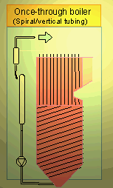
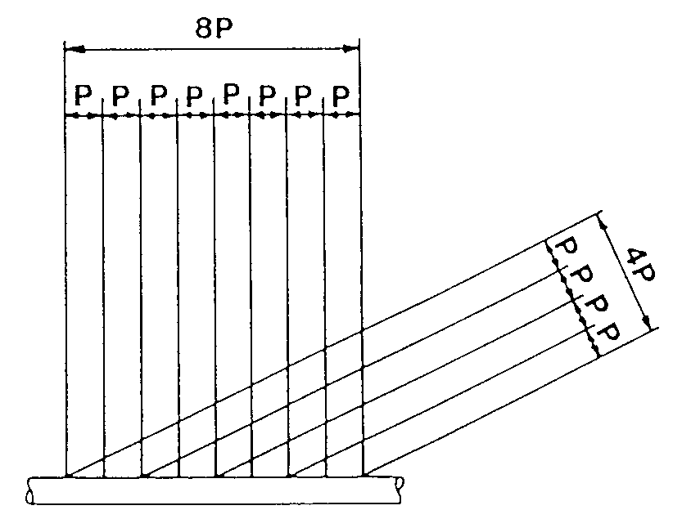
Spiral water walls

Slide 19
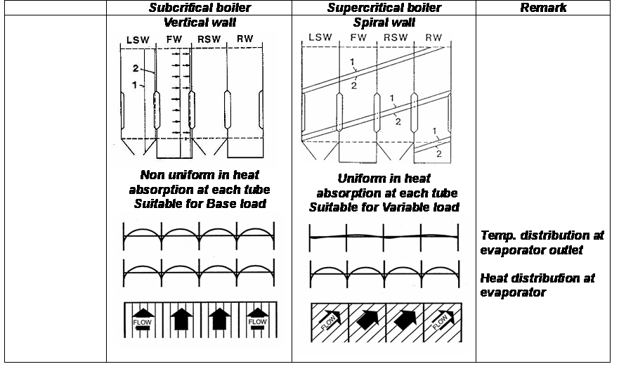
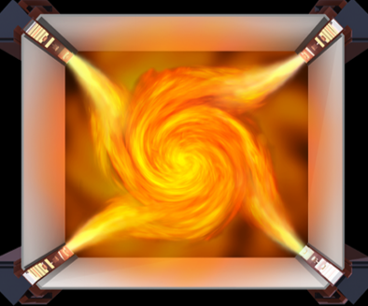

Slide 20
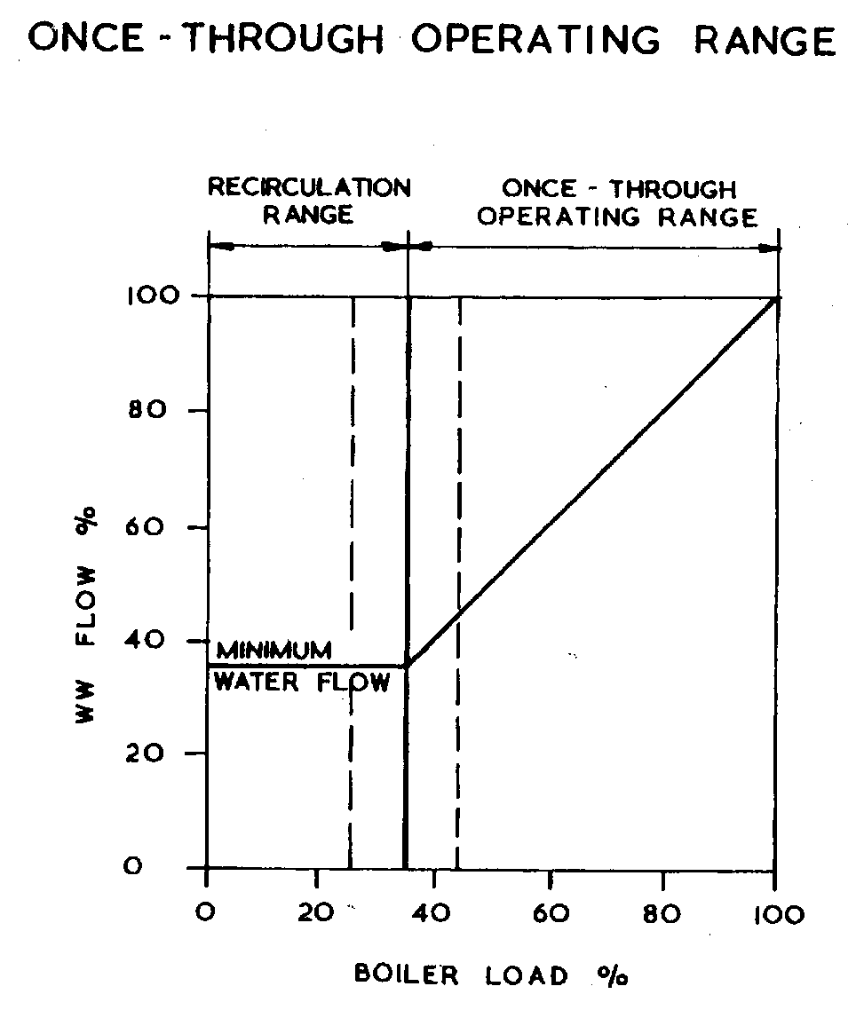
LOW LOAD CIRCULATION SYSTEM
At part loads , once through flow is
not adequate to cool the tubes.
To maintain mass velocity boiler
operates in circulating mode at
low loads

Slide 21
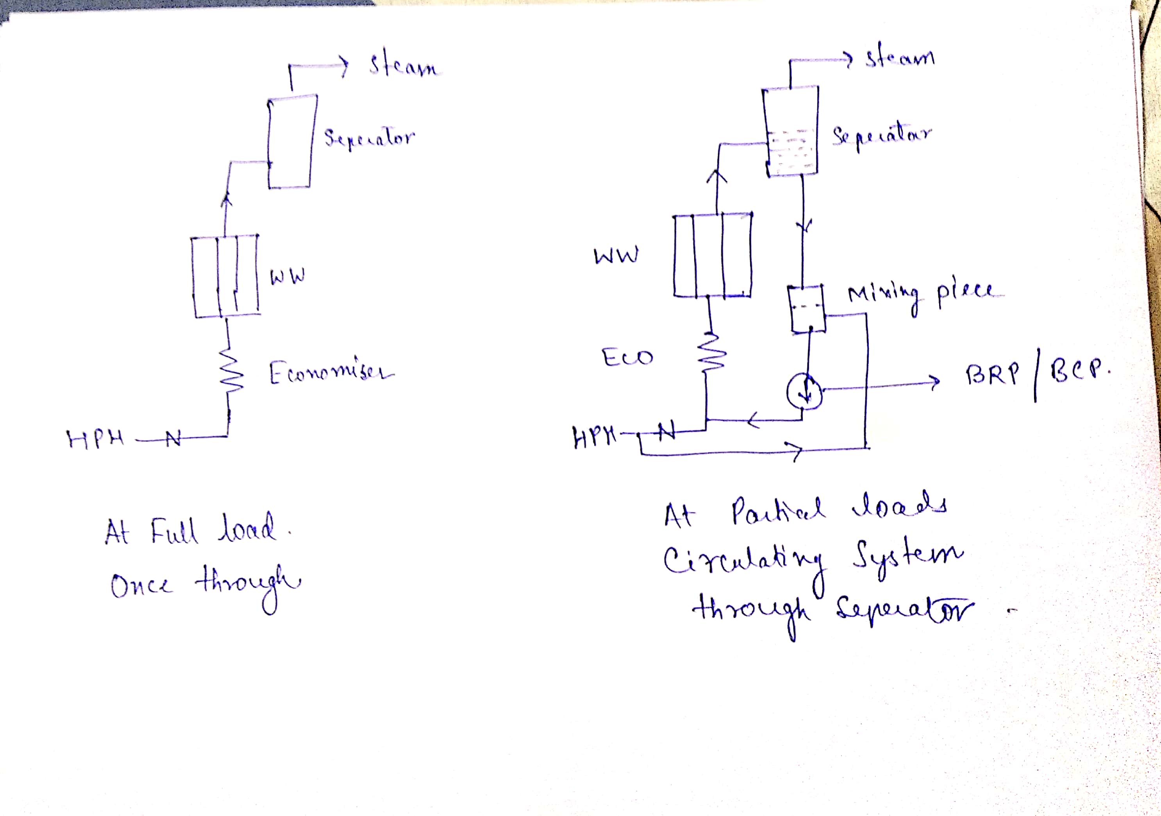

Slide 22
Description
Excess flow over the once through flow is circulated back to the water walls.
The excess water from the separator mixes with incoming flow from HPH in mixing piece and is forced through the heating elements through BRP.
The separator seperates steam and water during low loads and remain dry thereafter
Sepeartor is similar to a boiler drum but is smaller and remains in service only till the once through flow becomes greater than the minimum mass flow required for proper cooling of tubes

Slide 23
THANK YOU

